Slide 1

Bangladesh University of Business and Technology
Committed to Academic Excellence
Simon's Sequence
A Memory Tile Game Built with 2D Computer Graphics Algorithms and Digital Image Processing Techniques
Course
Intake & Date
CSE 452 – Graphics and Image Processing
44-02 | 16th July 2026
Submitted To
Project Team
Shaila Shaznin, Lecturer, Dept. of CSE (BUBT)
Md. Redwan Molla (20235203038)
Supriya Bosu (20235203072)
Simon's Sequence — CSE 452
1

Slide 2
SIMON'S SEQUENCE
A Memory Tile Game Built with 2D Computer Graphics Algorithms and Digital Image Processing Techniques.
Simon's Sequence — CSE 452
2

Slide 3




Core Gameplay Loop
How a single round of Simon's Sequence plays out, start to finish.
1. Observe
2. Replicate
The game generates a random sequence and flashes colored tiles one at a time.
The player must reproduce the exact sequence before the countdown timer runs out.
3. Progress
4. Fail State
Correct clicks trigger a scale/rotation animation, increase the score, and append a new tile.
An incorrect click instantly ends the round, triggering a Game Over state and post-game image processing.
Simon's Sequence — CSE 452
3

Slide 4
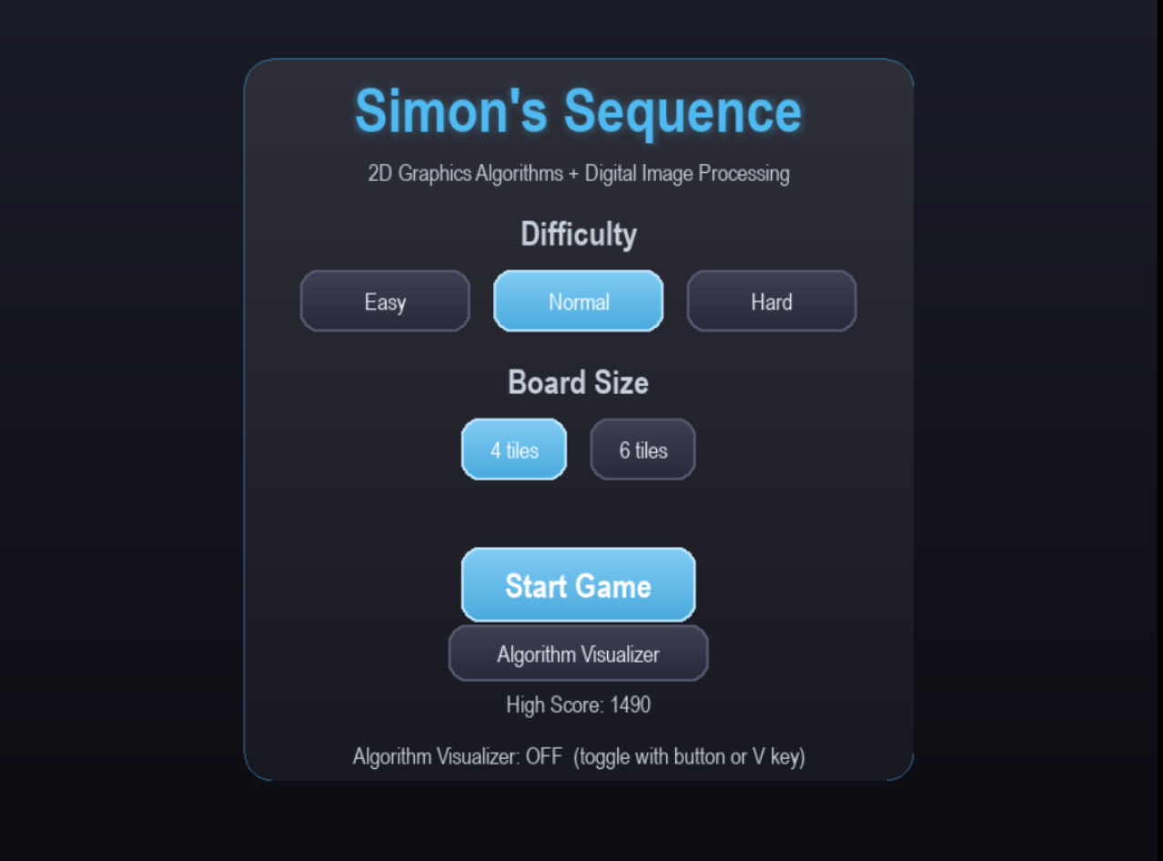
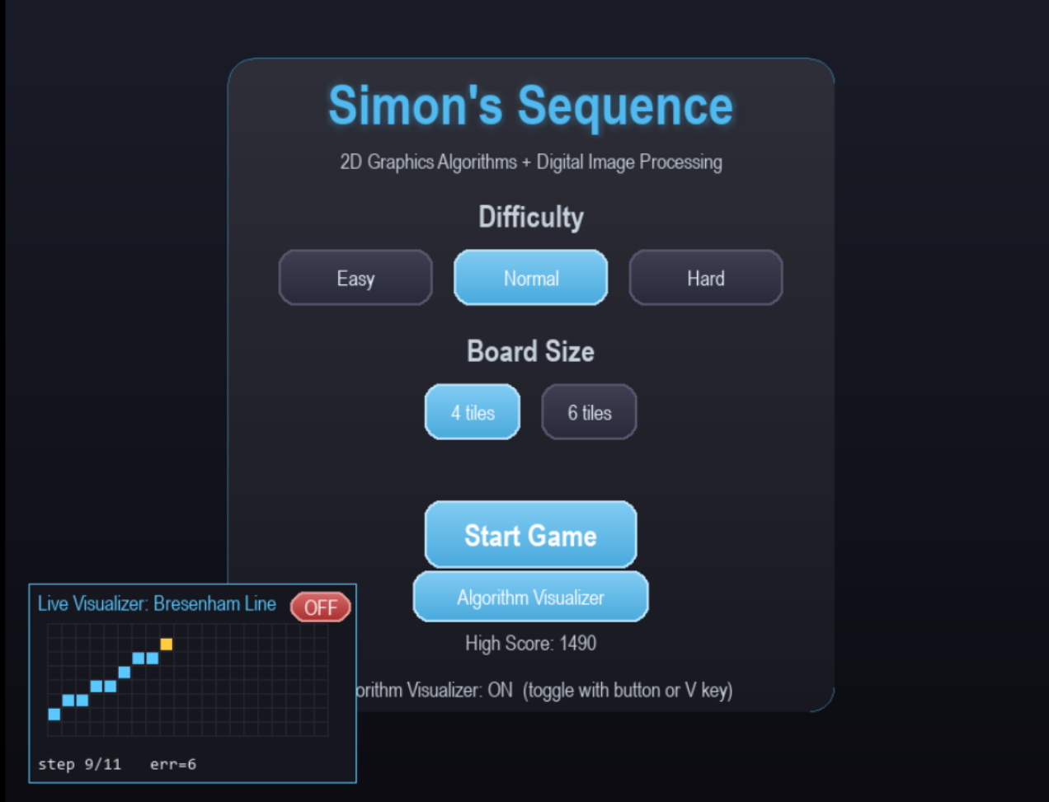
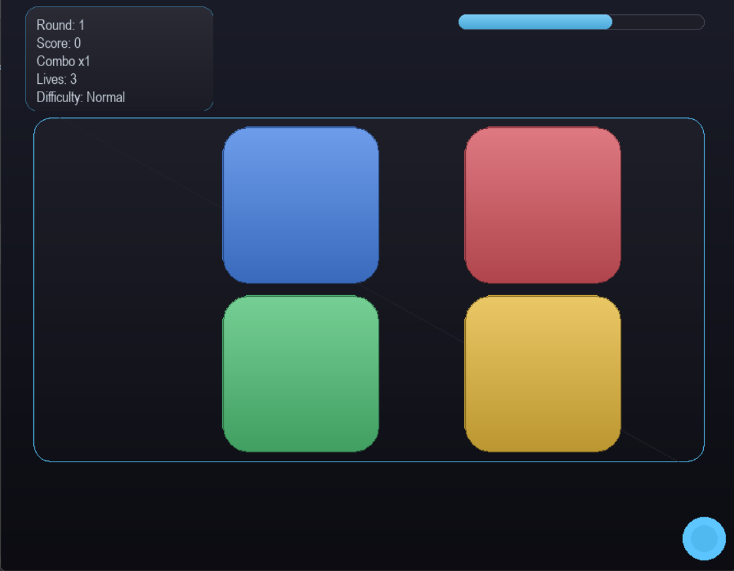
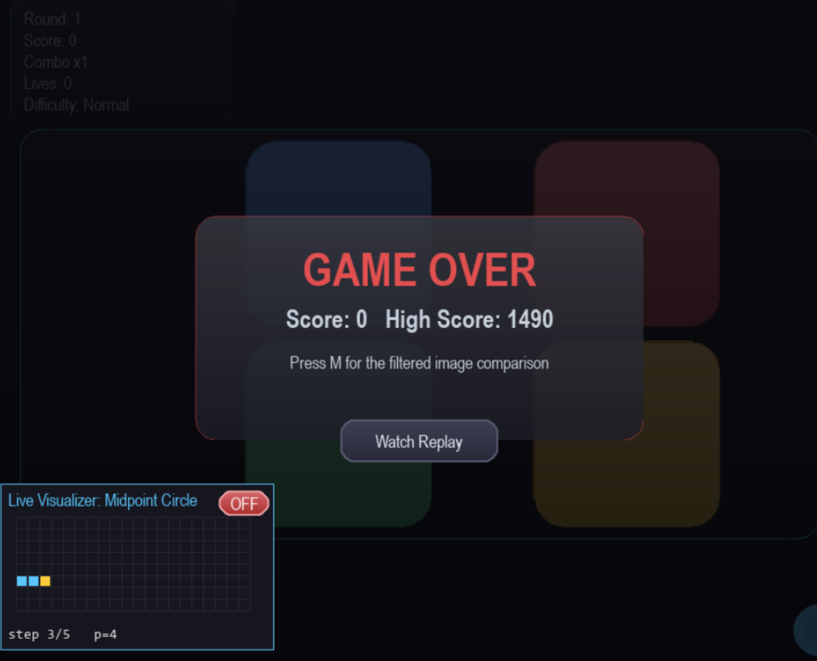
Gameplay in Action
Real screenshots captured from the running Pygame build.
Setup Menu — difficulty & board size
Live Algorithm Visualizer overlay
Active Round — HUD & tile field
Game Over & Replay prompt
Simon's Sequence — CSE 452
4

Slide 5




Core Educational Objectives
First Principles
Applied Motion
Implement core 2D drawing algorithms (DDA, Bresenham, Midpoint) purely from scratch — without built-in graphics functions.
Use 2D geometric transformations (translation, rotation, scaling) via NumPy matrices to animate game objects.
Constraining Boundaries
Live Vision
Apply line and polygon clipping to perfectly contain dynamic visual effects within playable zones.
Execute spatial filters, correlation, and convolution live during gameplay to alter the visual output.
Simon's Sequence — CSE 452
5

Slide 6
Anatomy of a Hand-Coded UI
Every visual element of the HUD traces back to a hand-written graphics algorithm.
Tile Borders
Driven by Bresenham's Line Algorithm
Glossy Panels
Driven by a Custom Gradient Scanline Fill
HUD Accent Dots
Driven by the Midpoint Circle Algorithm
Glow Highlights
Field Diagonals
Constrained by Sutherland-Hodgman Polygon Clipping
Driven by the DDA Line Algorithm
Actual gameplay screenshot
Simon's Sequence — CSE 452
6

Slide 7
The Graphics Algorithm Matrix
Category | Algorithms | Module | In-Game Application
Line Drawing | DDA & Bresenham | graphics_algorithms.py | Renders the decorative field diagonal, visualizer grid, and sharp tile borders.
Circle Generation | Bresenham & Midpoint | graphics_algorithms.py | Renders the HUD accent dots and procedurally generated victory patterns.
Polygon Filling | Scanline & Custom Gradient | graphics_algorithms.py | Fills colored tiles, additive glow highlights, and glossy HUD backgrounds.
Simon's Sequence — CSE 452
7

Slide 8
Transformations & Clipping
Dynamic Animation
Constraining Reality
R(θ) = [ cosθ -sinθ ; sinθ cosθ ]
Using NumPy for matrix-based translation, rotation, and scaling (e.g., tile press feedback) rather than simple coordinate redrawing in transformations.py.
Implementing Cohen-Sutherland (clipping diagonals to the field) and Sutherland-Hodgman (clipping glow effects to exact tile boundaries) in clipping.py.
Simon's Sequence — CSE 452
8

Slide 9
Extended Concept: Image Processing Effect Tiles
Blue Tile
Red Tile
Mean / Blur Filter
Sharpening Filter
Live screen blur on correct hit.
Live edge enhancement on correct hit.
Green Tile
Yellow Tile
Sobel / Prewitt Edge-Detection
Emboss Filter
Live edge extraction on correct hit.
Live 3D depth illusion on correct hit.
Key Insight: Every correct click functions as a live demonstration of custom correlation/convolution functions driven by image_filters.py.
Simon's Sequence — CSE 452
9

Slide 10


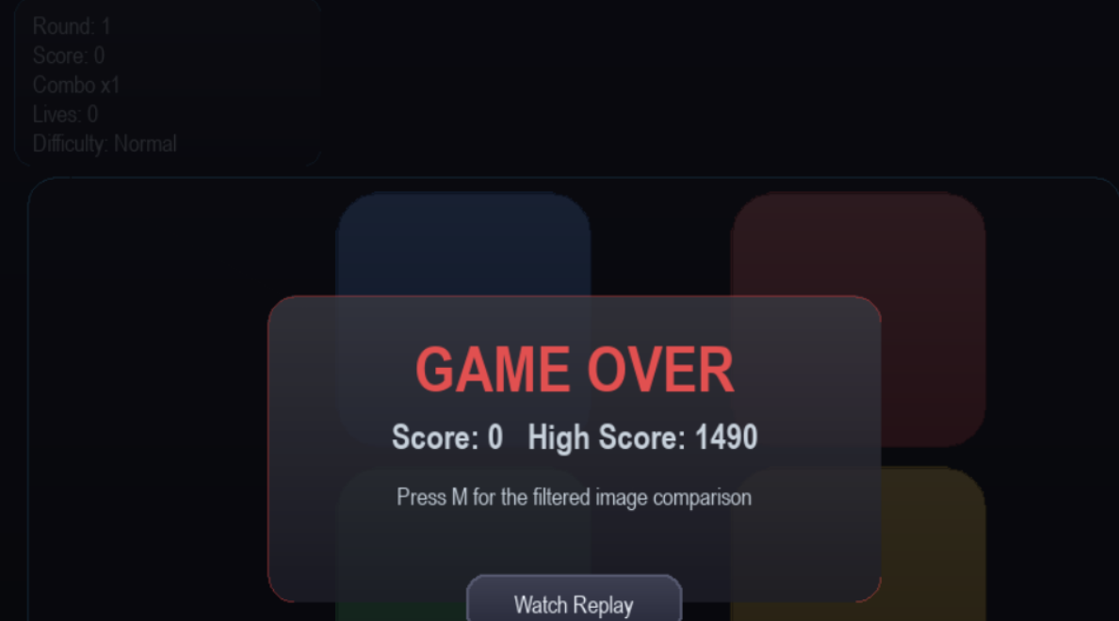
Post-Game Processing & Matplotlib Integration
1. The Capture
2. The Processing
3. The Output
An automated screenshot is taken the moment a 'Game Over' occurs.
The image is passed through custom spatial filters (mean, median, sharpen, edge detection).
The player presses 'M' to launch Matplotlib, displaying the original and mathematically filtered versions side-by-side for academic comparison.
Simon's Sequence — CSE 452
10

Slide 11
Technical Architecture & Stack
Window rendering, input events, sound, and post-game image comparisons. Crucial Note: Pygame is strictly used for the window — no built-in drawing functions are used!
UI / Visualization
Pygame & Matplotlib
graphics_algorithms.py, clipping.py, image_filters.py acting as a completely custom graphics and convolution engine.
Custom Engine
Hand-Written Python Modules
Handling all matrix transformations, pixel array operations, and filter calculations.
Math Foundation
Python 3 & NumPy
Simon's Sequence — CSE 452
11

Slide 12
The “Glass & Glow” UX Redesign
Highlighted Elements
Rounded, gradient-filled tiles with soft additive glow halos.
Translucent glass panels used for the HUD and pause menus.
Cached vertical-gradient backgrounds for performance.
Tile Gradient
Glow Halo
The Technical Catch: This modern aesthetic is achieved entirely from scratch using custom rounded_rect_points, fill_polygon_gradient, and Pygame PixelArrays for horizontal scanline speed.
Pause Menu
Simon's Sequence — CSE 452
12

Slide 13



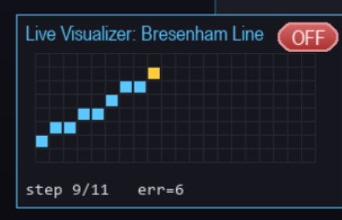
Advanced Bonus Features
Live Algorithm Visualizer (V)
Automated Replay System (R)
Flood Fill Victory Sequence
A floating panel that continuously animates the DDA and Bresenham algorithms one step at a time, printing the math's decision variables in real-time.
Timestamped recording of all flashes and clicks, allowing frame-by-frame automated playback of the entire session — including live filter effects.
A stack-based flood fill algorithm that colors a procedurally generated victory shape (star/flower) every 5 successful rounds.
Simon's Sequence — CSE 452
13

Slide 14

Future Work
Game Level System Integration
Propose the development of a progressive level system for the game, introducing new challenges, visual elements, and gameplay mechanics at each stage.
Simon's Sequence — CSE 452
14

